Slide 1
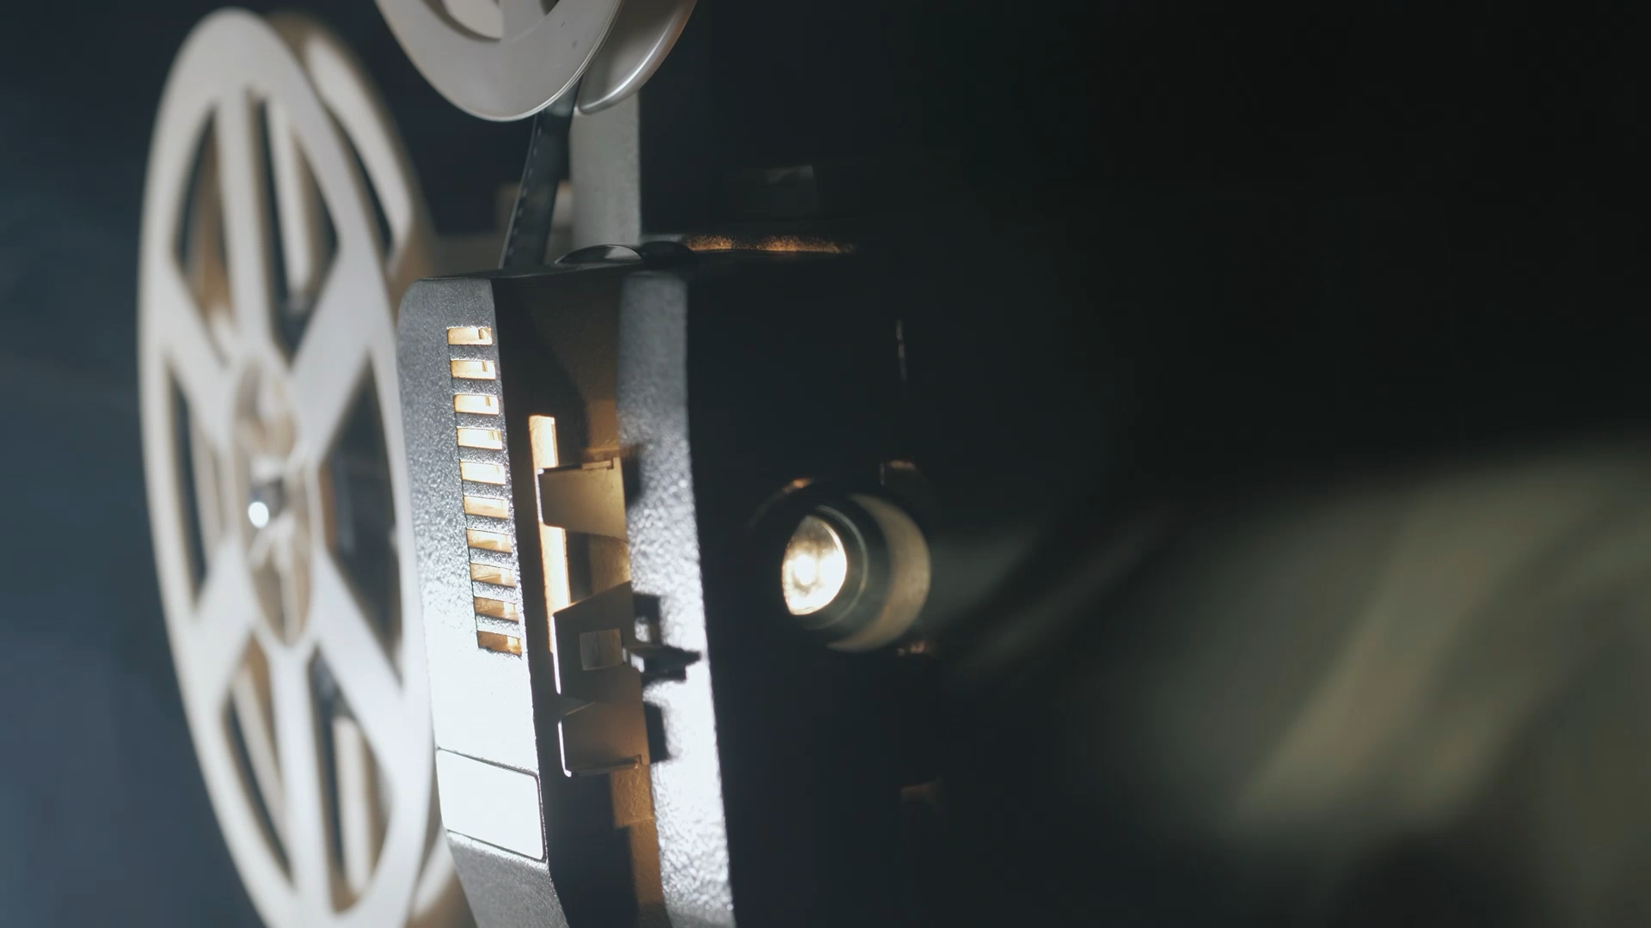
Movie Recommendation system
Murali krishna Avula
KB85699
Prepared for: UMBC Data Science Master Degree Capstone by Dr. Chaojie (Jay) Wang
Notes:
Hello professor ,hello everyone today i will present the Movie recommedation system

Slide 2
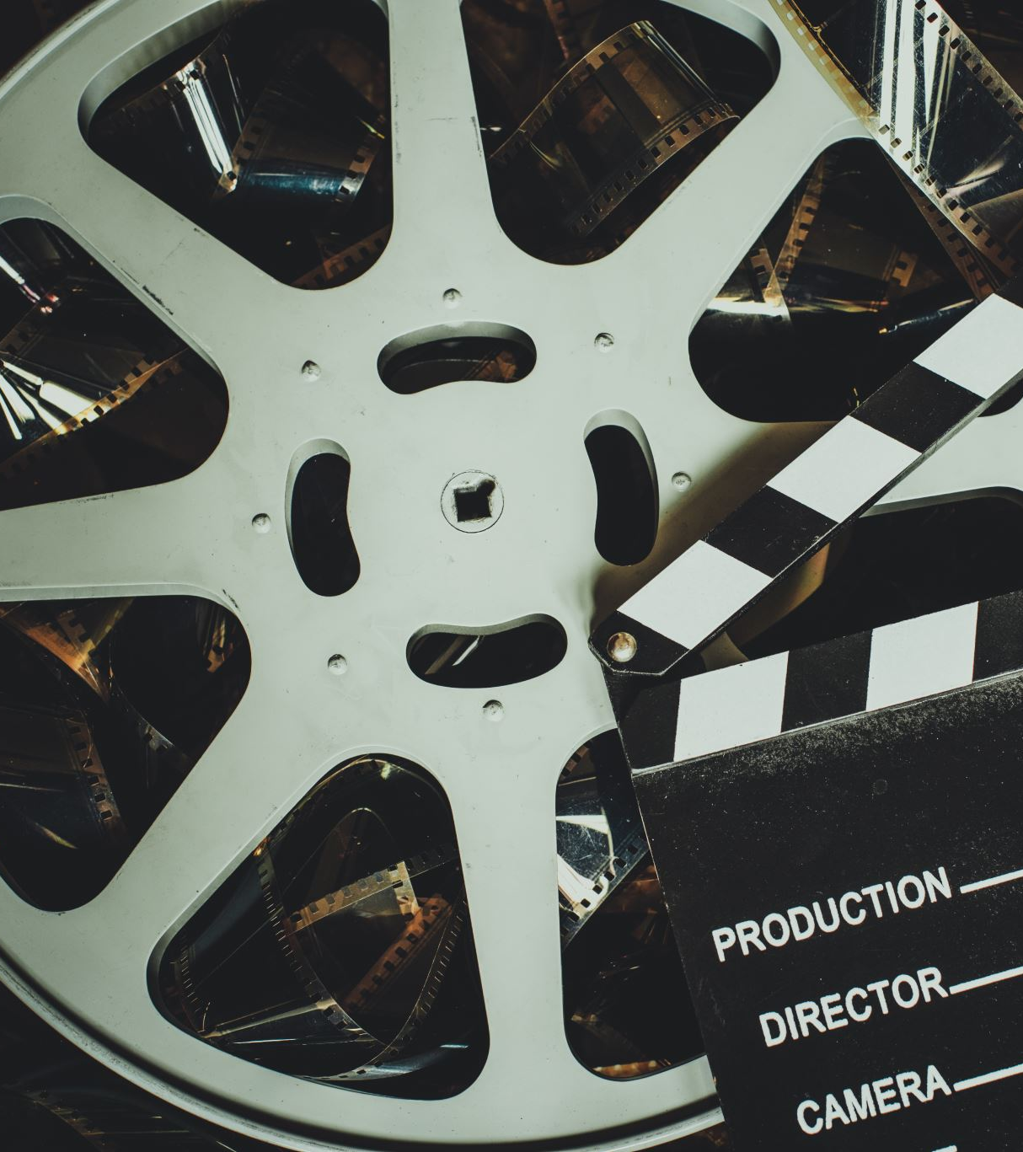
Background
The movie recommendation system aims to provide personalized movie recommendations to users based on their preferences and behavior.
With the increasing popularity of streaming platforms, such systems play a crucial role in enhancing user experience and engagement.

Slide 3
Research Questions:
How can we leverage user preferences and movie attributes to generate accurate recommendations?
What machine learning algorithms and techniques are most effective for building a movie recommendation system?
How can we evaluate the performance and effectiveness of the recommendation system
Notes:
today we will see how can we

Slide 4
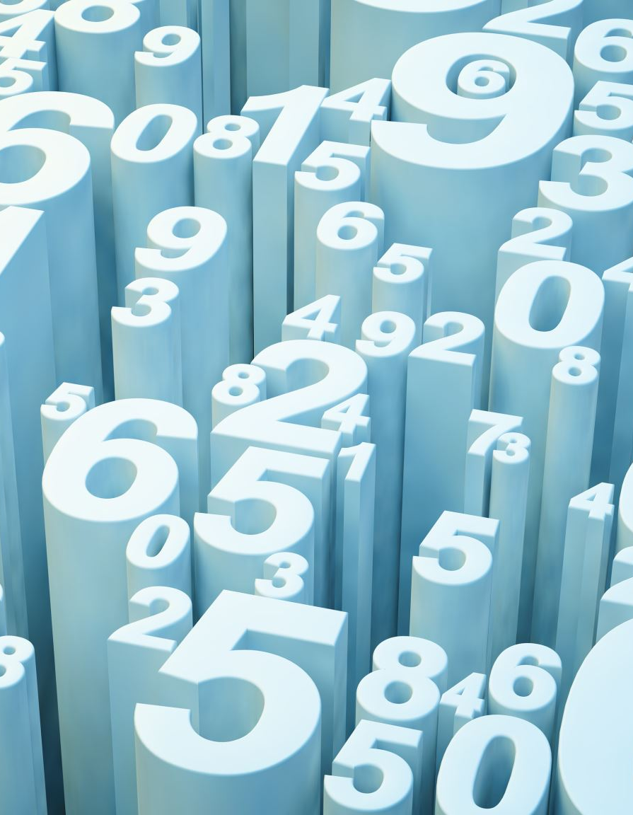
Data
Data Sources
The primary data source for this project is the https://www.themoviedb.org/ , which contains information about Movies,budget,production house and more.
Additional data sources may include movie credits, and cast.
Data Size
The dataset is approximately 45 MB.
It consists of 4804 rows and 20 columns.
Time data :1919 to 2016
Notes:
This provides the information about the dataset we are using for our model

Slide 5
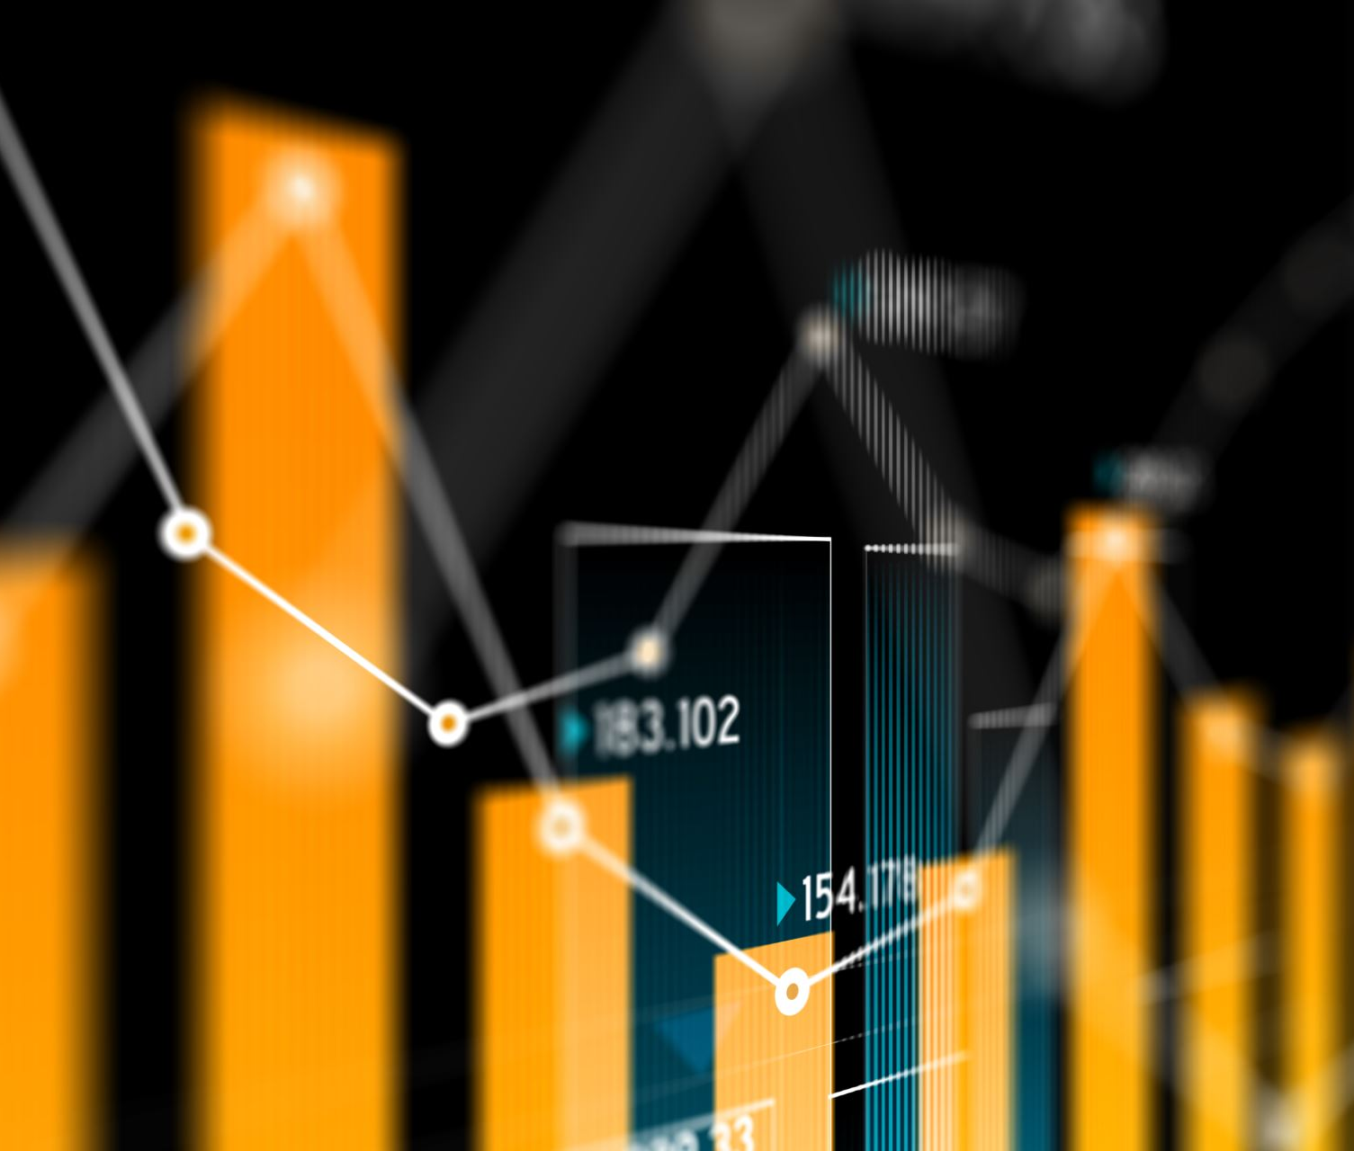
Features/Predictors
Potential features for the ML models include:
Overview
Genres
Keywords
Original Language
Popularity
Release Date
Production Companies
Notes:
this are the major attributes we will be concentrating to get the recommendations

Slide 6

Machine learning
Collaborative filtering :
The Collaborative filtering method finds other users and customers similar to you and recommends their choices.
Content based filtering:
uses item features to recommend other items similar to what the user likes, based on their previous actions or explicit feedback
Notes:
in My model i am using these two for the recommendation generation

Slide 7

Model
For content-based recommendation, we will preprocess text data, apply TF-IDF vectorization, and calculate cosine similarity between items.
For collaborative filtering, we will use nearest neighbours algorithm.
We use pandas For data manipulation and preprocessing
Notes:
The training process for content based invloves

Slide 8
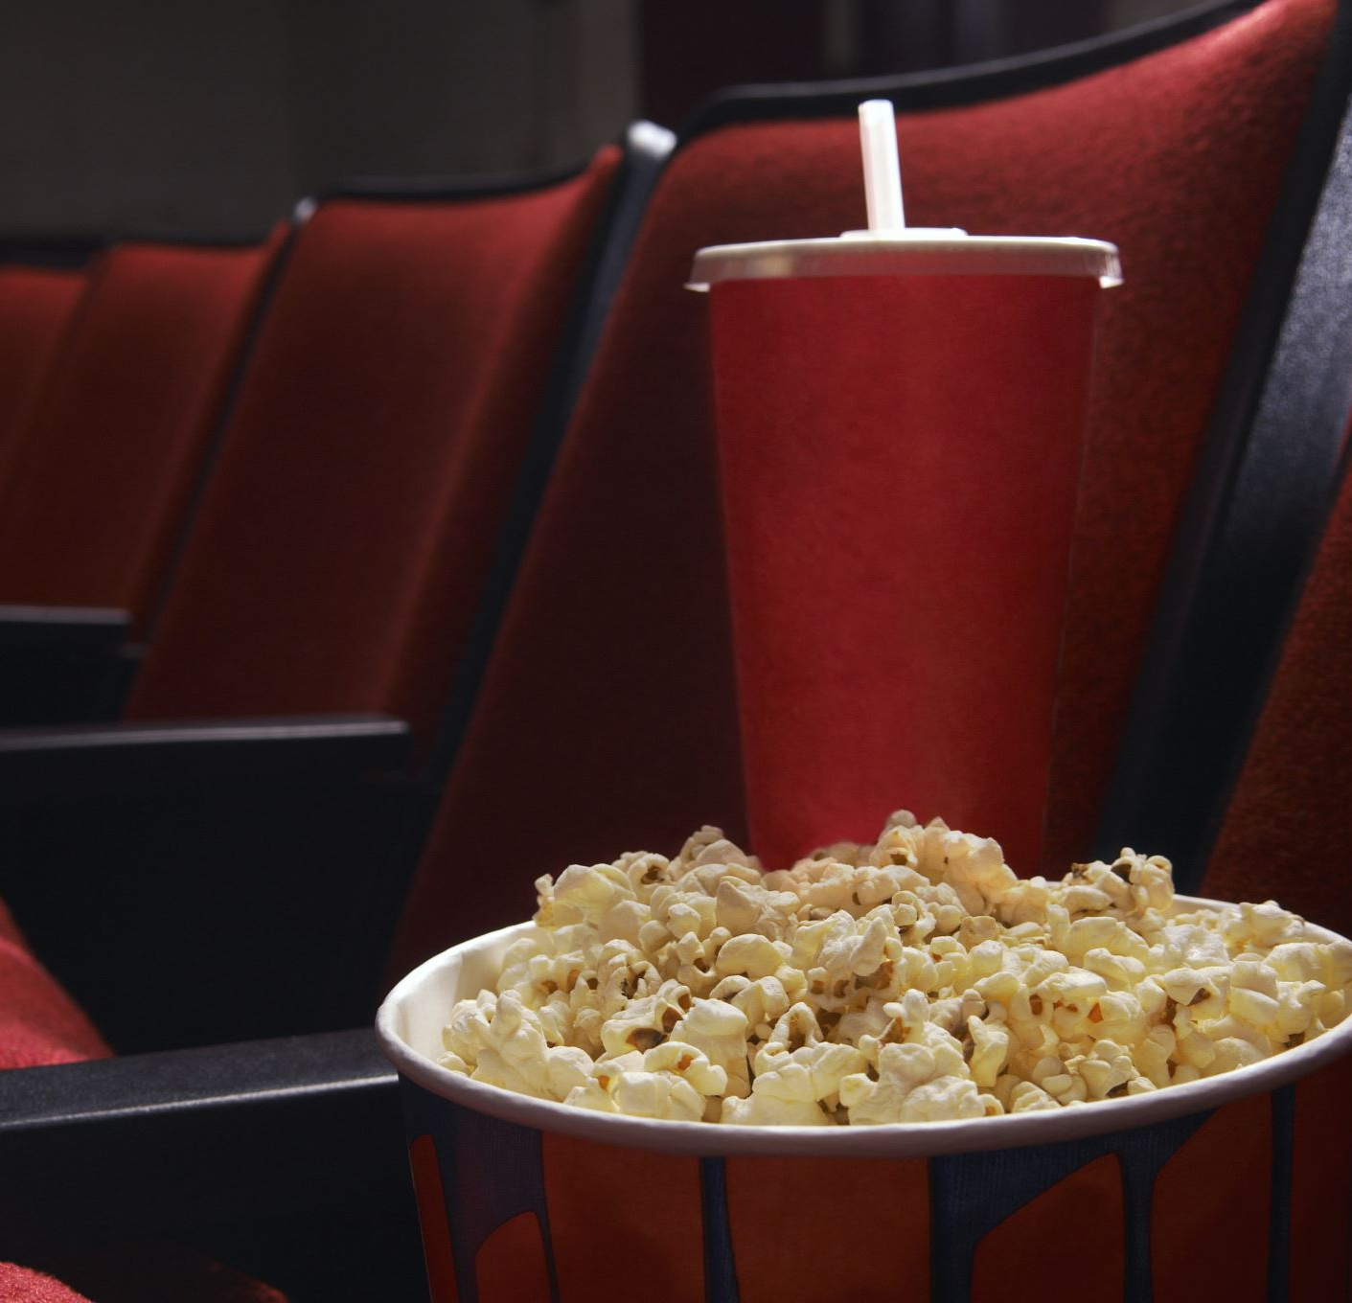
Tools
Python
Jupyter notebook
Github codespaces
Stream lit

Slide 9
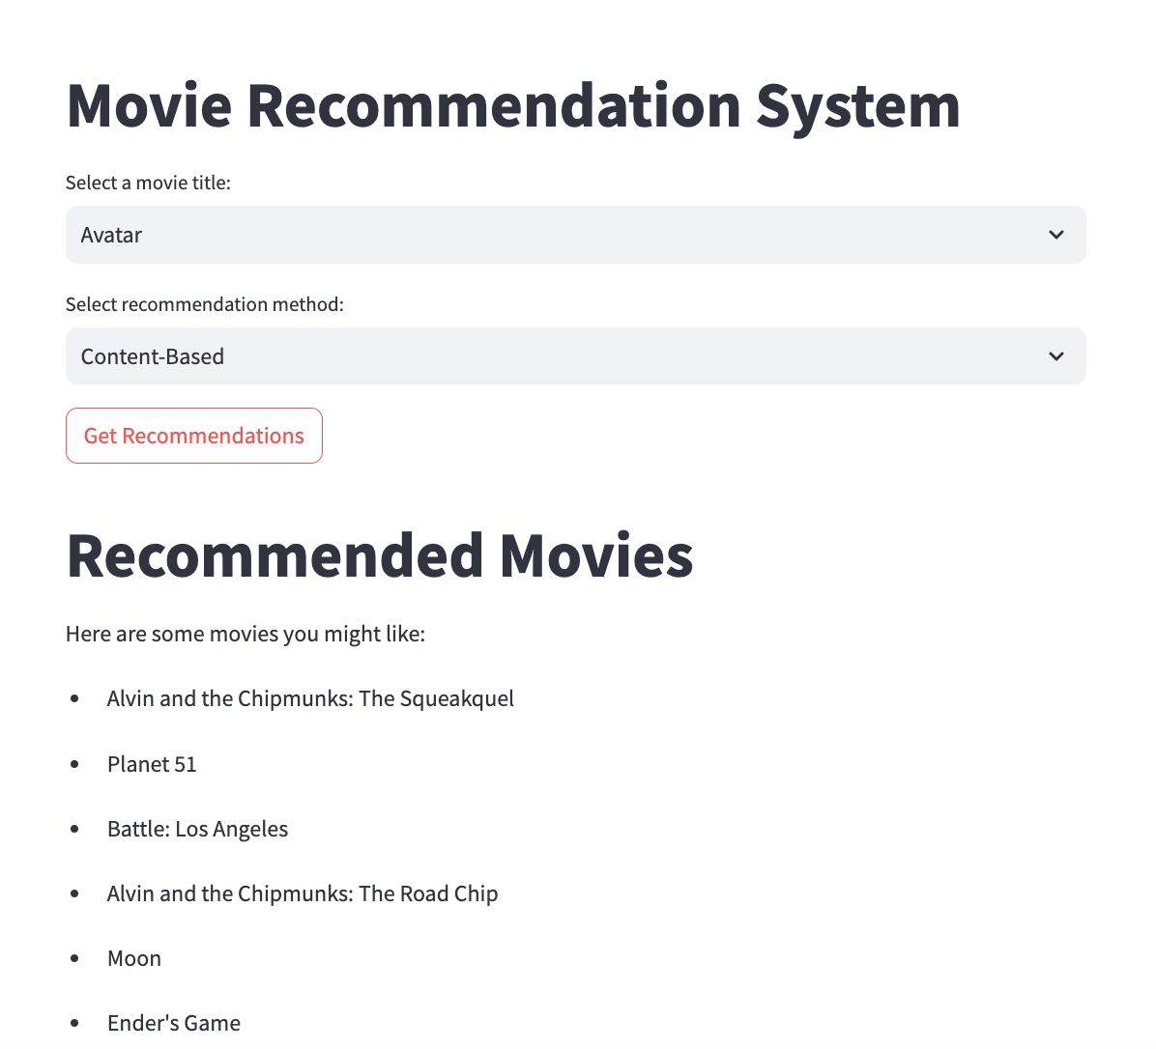
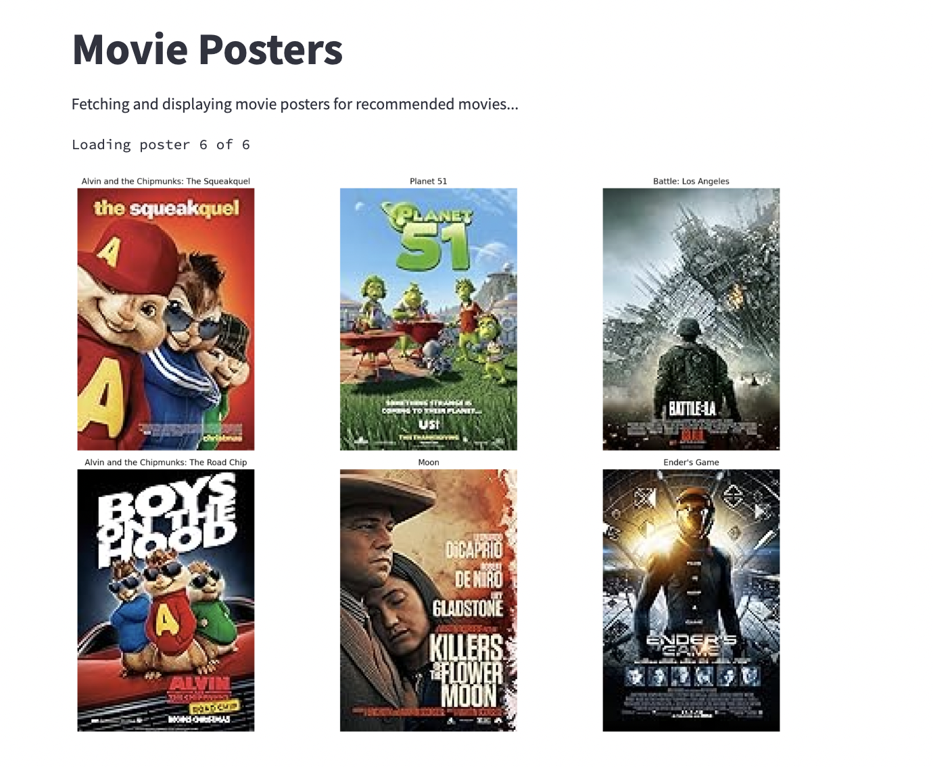
Screenshots

Slide 10
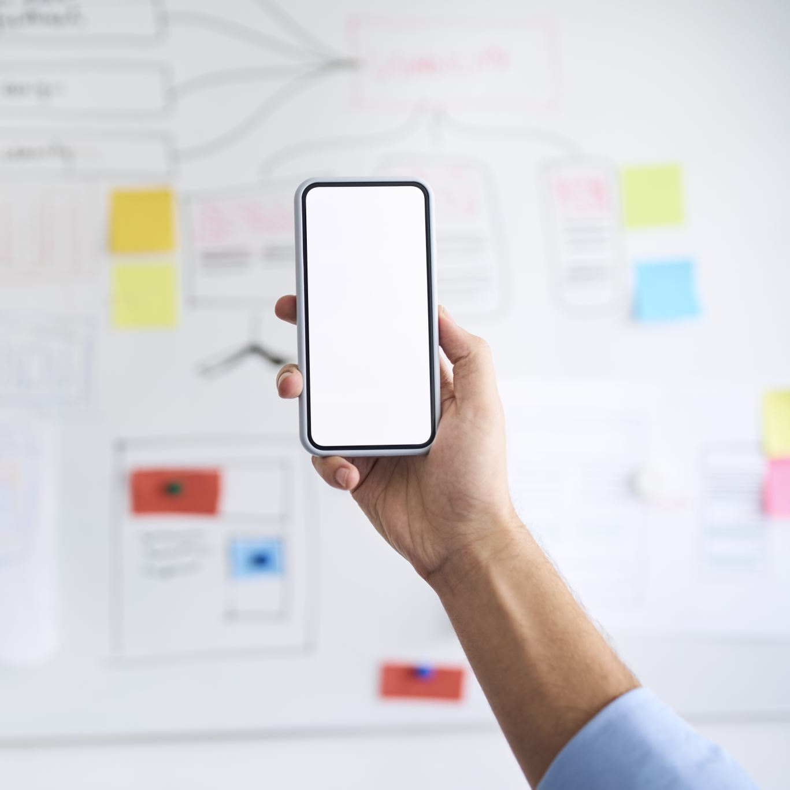
Demo
Developed a web application using Stream lit for users to interact with our trained recommendation models.
Streamliapp: (https://movierecommendationsystemapp.streamlit.app/)

Slide 11

Thank you

